Slide 1
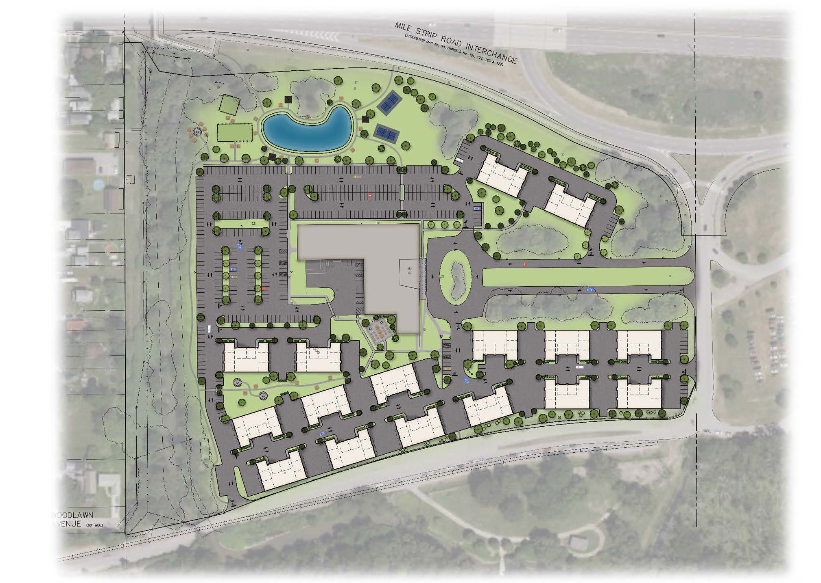
Gateway
Planned Unit
Development
3556 Lake Shore Road
Hamburg, New York 14219
Chris Wood, Carmina Wood Design
Marc A. Romanowski, Esq., Rupp Pfalzgraf LLC

Slide 2
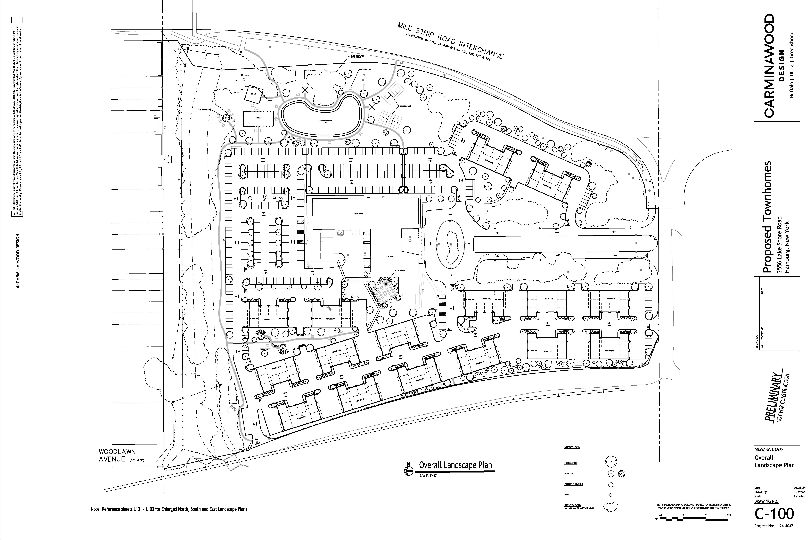
Gateway Planned Unit Development
~25 acre Mixed-Use Site
Reimagine the existing site and maintain its natural beauty and natural features.
Increase in tree planting and other landscaping.
Residential: Offering Townhomes, Condominiums, and Luxury Apartments.
Commercial: Restaurants, Hotel Space, Office Space.

Slide 3
Gateway Planned Unit Development
137,000 SF Tower
  4 floors of Residential uses, with 10 units per floor
  Rooftop Feature
    Maximum height of 120’ (existing 103’)
16 five-story Townhomes
438 parking spaces
  128 two-car garages = 256 parking spaces for Townhomes
  182 spaces for Tower users

Slide 4
Gateway Planned Unit Development
Existing Zoning
C-3 Office District and Route 5 Overlay District
Bulk Requirements
85’ maximum building height
100’ minimum lot width
40’ minimum front setback/50’ max
25’ minimum side setback (2 required)
20’ minimum rear setback
25’ minimum rear setback along R boundary
35’ parking setback from street line /10’ from side lot line
10%/15% total landscaping 5% interior lot

Slide 5
Gateway Planned Unit Development
Existing Zoning
Comprehensive Plan
Key Goals
Revitalize Woodlawn Area
Improve connections within waterfront area and to the rest of the community
Maintain/Improve waterfront character
Improve waterfront aesthetic

Slide 6
Gateway Planned Unit Development
PUD Requests
Proposed Requirements
Additional permitted uses of residential, restaurant(s) and hotel
60’ maximum building height for Townhomes
  Up to 120’ for Tower (103’ existing)
0’ minimum lot width
15’ minimum front setback
10’ minimum side setback
0’ minimum rear setback
10’ minimum front parking setback and 0’ side

Slide 7
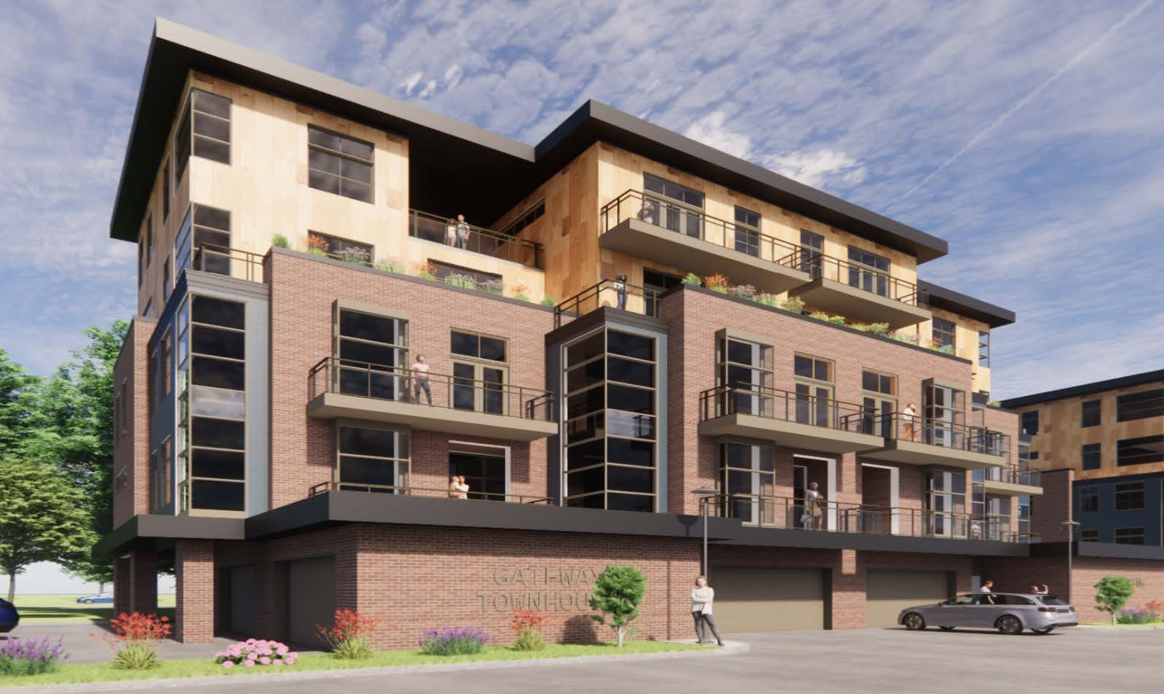
Gateway Planned Unit Development
Preliminary Concept

Slide 8
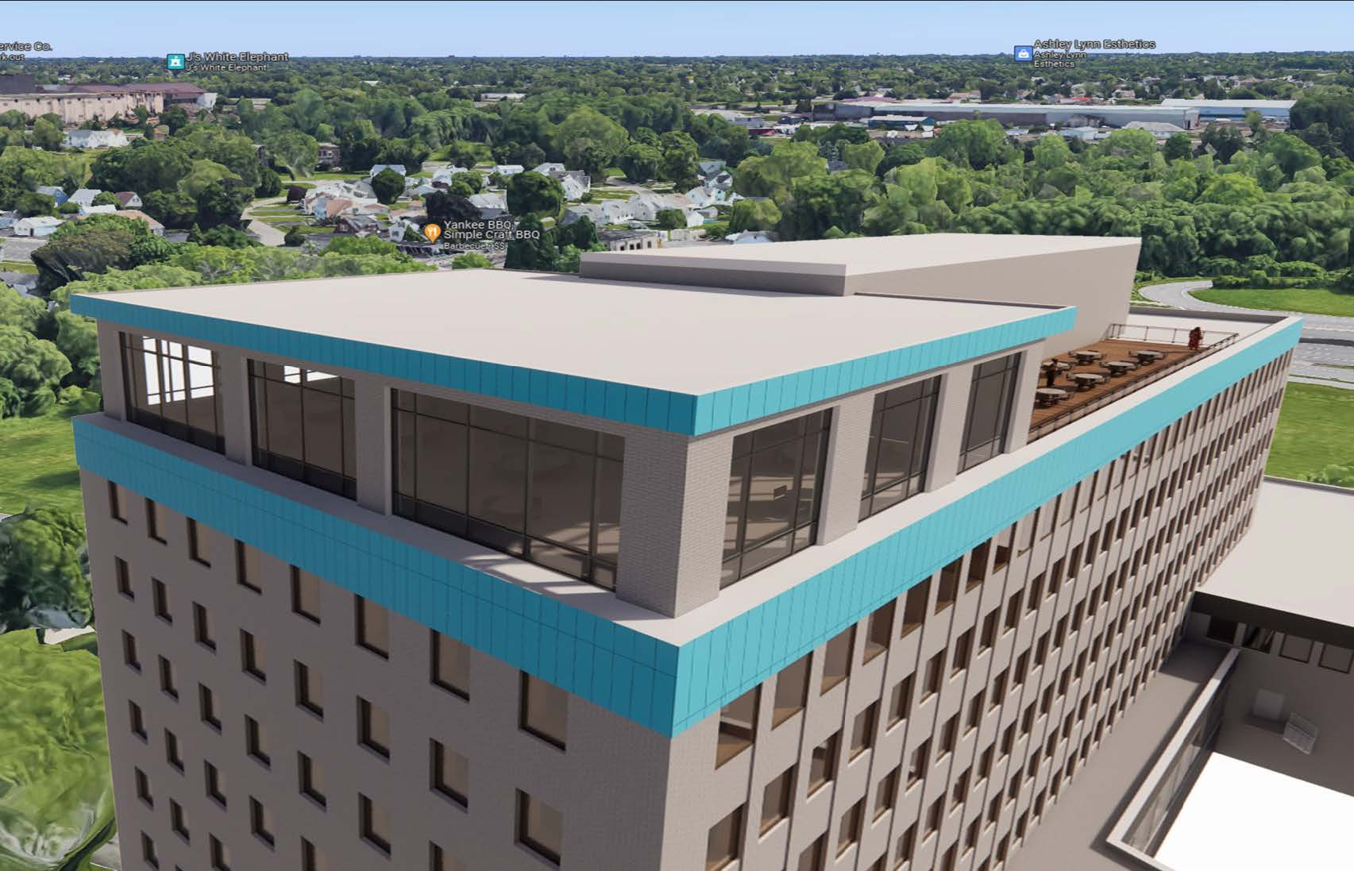
Gateway Planned Unit Development
Preliminary Concept
* Rooftop feature

Slide 9
Questions?

